Slide 1
Key Indicators in predicting a Heart Attack
Arpit Dang
Data Science Institute at Brown University
October 23rd, 2024
https://github.com/adang66/Data1030-Project

Slide 2
More information about the dataset
Why:
1 in 5 deaths in the United States are related to heart diseases ¹
On average, someone in United States has a heart attack every 40 seconds ²
About 47% of Americans have at least 1 of the 3 major risk factors for heart diseases: high blood pressure, high cholesterol or smoking ³
What: Telephone surveys among 400k+ American adults that collected variables that may contribute to heart attacks
Who: Collected by the Centers for Disease Control and Prevention (CDC)
When: It was collected in the year 2022 (relatively recent)
Notes:
Martin SS, Aday AW, Almarzooq ZI, et al.; American Heart Association Council on Epidemiology and Prevention Statistics Committee; Stroke Statistics Subcommittee. 2024 heart disease and stroke statistics: a report of US and global data from the American Heart Association. Circulation. 2024;149:e347–913.
Tsao CW, Aday AW, Almarzooq ZI, et al. Heart Disease and Stroke Statistics—2023 Update: A Report From the American Heart Association. Circulation. 2023;147:e93–e621.
Fryar CD, Chen T-C, Li X. Prevalence of uncontrolled risk factors for cardiovascular disease: United States, 1999–2010. NCHS Data Brief. 2012;(103):1–8.

Slide 3
More information about the dataset (cont’d)
There were initially 400k+ adult data points in the dataset, however the authors removed the data points with missing values leaving 246,022 data points
The survey initially included approximately 300 variables but it was reduced to 39 variables they thought would be the most suitable for this dataset
Target Variable: If the participant had a heart attack; (Yes OR No); making this a classification problem

Slide 4
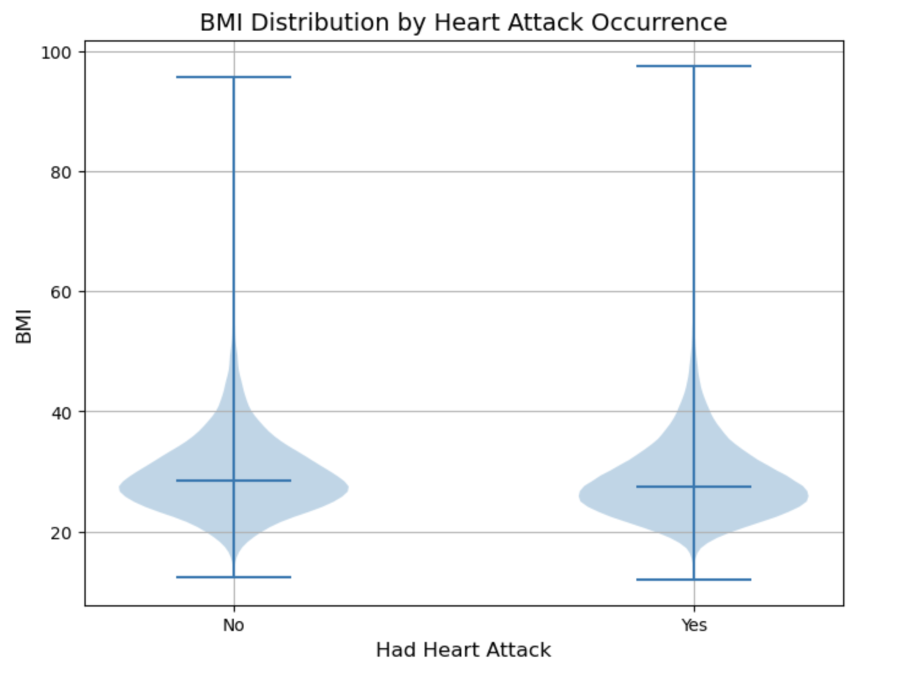
BMI Distribution by Heart Attack Occurrence
Expected that people who have had a heart attack would have a higher BMI ⁴
But the BMI of people with and without heart attack was relatively the same
Odd because you would expect higher median BMI in people who have has a heart attack occurrence
Notes:
4.Adams, B., Jacocks, L., & Guo, H. (2020). Higher BMI is linked to an increased risk of heart attacks in European adults: A Mendelian Randomisation study. BMC Cardiovascular Disorders, 20(1). https://doi.org/10.1186/s12872-020-01542-w

Slide 5
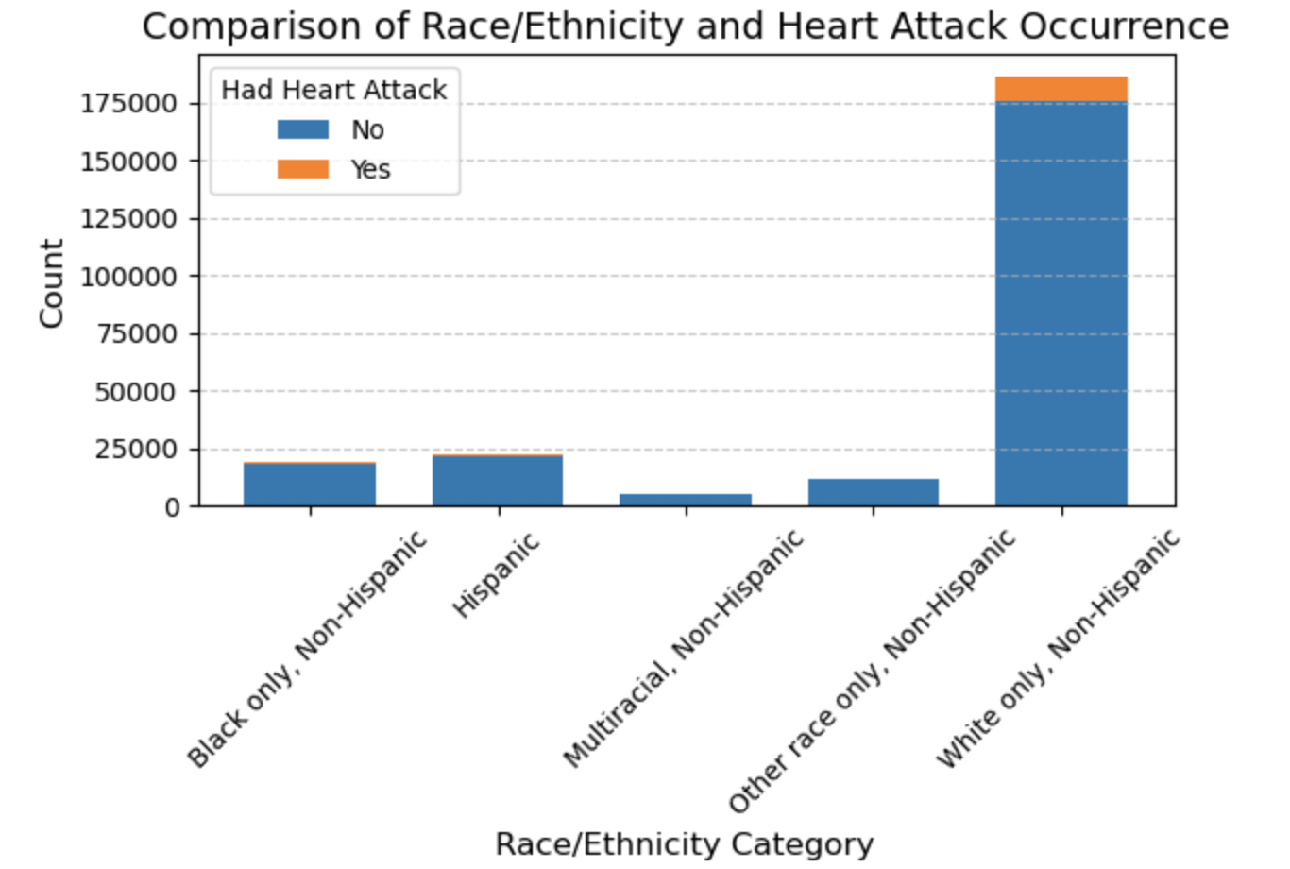
Heart Attack Occurrence by Ethnicity & Race
There is a lack of representation in data for most non-white races in this dataset
It does somewhat correlate with the distribution of the American population ⁵
Here are percentages for people who suffered a heart attack by ethnicity/race:
6.5% in Multiracial
6.1% in White
5.1% in Other Races
4.8% in Black
4.0% in Hispanic
Notes:
5. U.S. Census Bureau quickfacts: United States. United States Census Bureau. (2023, July 1). https://www.census.gov/quickfacts/

Slide 6
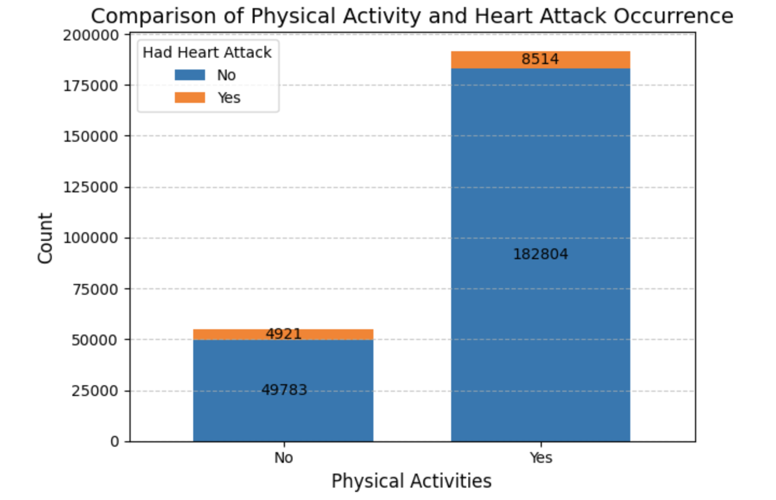
Comparison of Physical Activity & Heart Attack Occurrence
9.8% of people had a heart attack occurrence that did not participate in physical activity
4.7% of people had a heart attack occurrence that participated in physical activity
Limitation: not descriptive enough. 23/39 variables in the dataset are binary (Yes OR No)

Slide 7
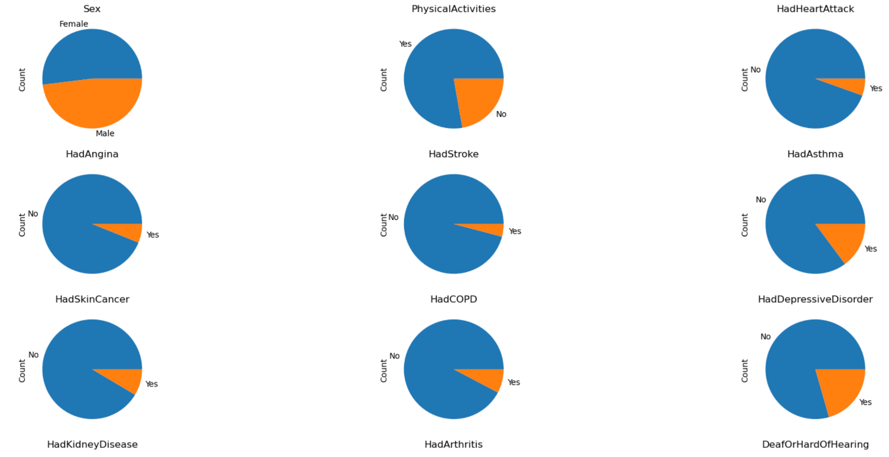
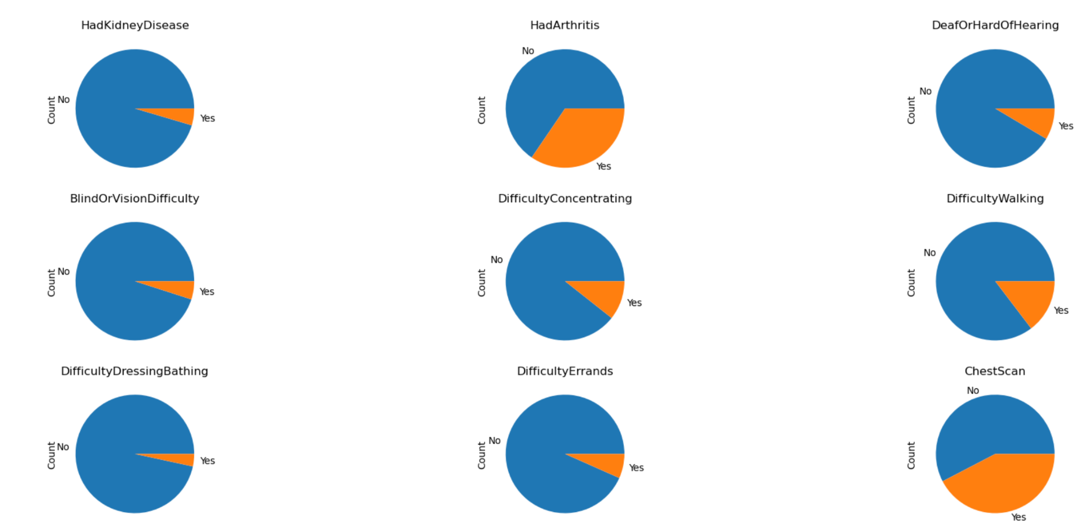
Binary Features
23/39 features are binary features.
Limitation: limited information representation (ordinal might be better), lack of qualitative data, it can lead to reduced model accuracy or interpretability

Slide 8
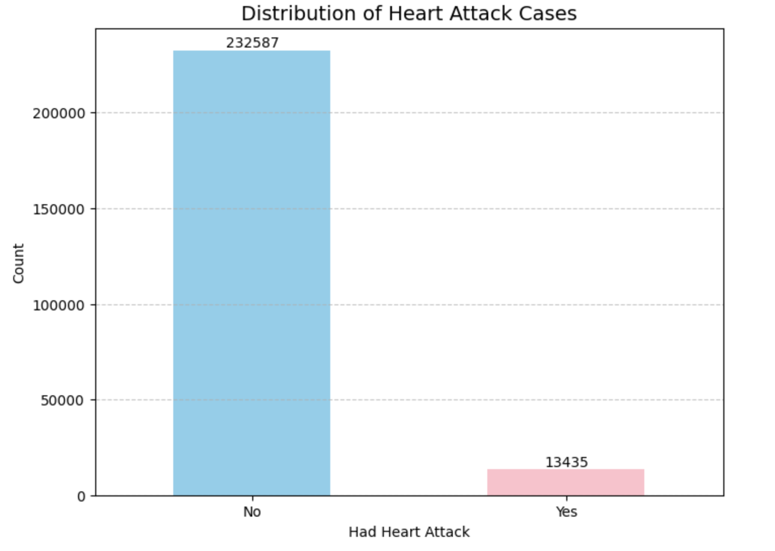
Distribution of Heart Attack Cases (target variable)
This is an independently and identically distributed (i.i.d) dataset
No missing values
5.5% of the participants has an incident of a heart attack, making it an imbalanced dataset
Solution: stratified split

Slide 9
Stratified split
60% training set, 20% validation set, 20% test set
Type of set | Total data points | ‘No’ to HadHeartAttack | ‘Yes’ to HadHeartAttack
Training set | 147 613 | 139 552 | 8 061
Validation set | 49 204 | 46 517 | 2 687
Test set | 49 205 | 46 518 | 2 687

Slide 10
Preprocessing
OneHotCoder: 27 features (categorical features)
OrdinalEncoder: 6 features (ordinal features)
MinMaxScalar: 6 features (continuous features)
X_train.shape = (147 613, 39)
X_train_prep.shape = (147 613, 126)

Slide 11
Thank you for listening!
Questions?

Slide 12
References
Martin SS, Aday AW, Almarzooq ZI, et al.; American Heart Association Council on Epidemiology and Prevention Statistics Committee; Stroke Statistics Subcommittee. 2024 heart disease and stroke statistics: a report of US and global data from the American Heart Association. Circulation. 2024;149:e347–913.
Tsao CW, Aday AW, Almarzooq ZI, et al. Heart Disease and Stroke Statistics—2023 Update: A Report From the American Heart Association. Circulation. 2023;147:e93–e621.
Fryar CD, Chen T-C, Li X. Prevalence of uncontrolled risk factors for cardiovascular disease: United States, 1999–2010. NCHS Data Brief. 2012;(103):1–8.
Adams, B., Jacocks, L., & Guo, H. (2020). Higher BMI is linked to an increased risk of heart attacks in European adults: A Mendelian Randomisation study. BMC Cardiovascular Disorders, 20(1). https://doi.org/10.1186/s12872-020-01542-w

